Slide 1

Arrow: Generating Signatures to Detect Drive-by Download Attacks
Dr. Junjie Zhang
Assistant Professor

Slide 2



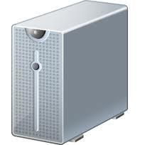
The Lifecycle of Internet Malware
Infection Phase
Scan&Exploit
Spam
Drive-By download
commands
Control Phase
Centralized structures
P2P structures
Attacks
Attack Phase
DDoS
Spamming
Search Engine Abuse
Notes:
Scan&Exploit
Spam
Drive-By download……
Centralized architecture
P2P architecture
DDoS
Spamming
Search engine abuse……

Slide 3
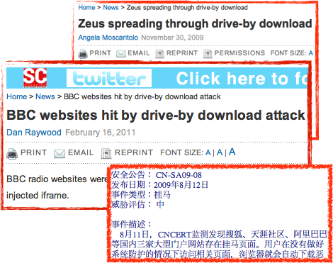
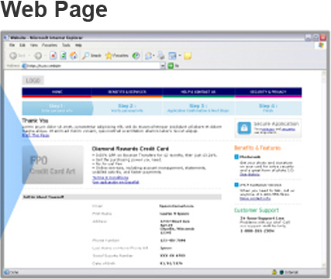
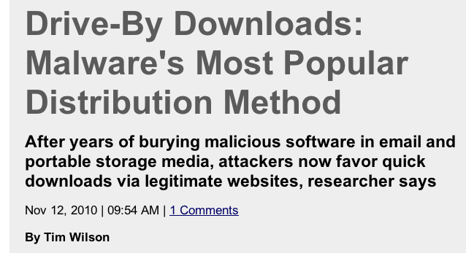


Detecting Drive-By Download Attacks
J. Zhang, C. Seifert, J. Stokes, W. Lee, “ARROW: Generating Signatures to Detect Drive-By Downloads”, WWW 2011.
Drive-By Download
The download of malware through vulnerable web browsers without user’s authorization
The most popular method to distribute malware
Notes:
Detecting malware in its infection phase is important and useful. It can prevent

Slide 4



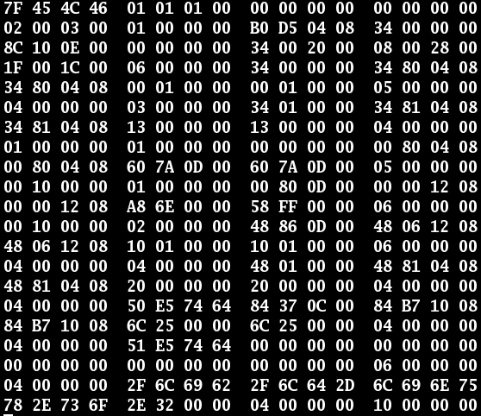
An Example of A Drive-By Download Attack
landing page
Landing Page
www.lp.com/page.php
www.lp.com/page.php
…
HTTP Response
Redirection Page www.fifth.com/t.php
Advertisement content
www.fifth.com/t.php
…
Redirection Page
www.rs.com/go.js
www.rs.com/go.js
Redirection Server
www.exploit.com/hack.exe
…
Exploit Page
www.exploit.com/hack.exe
Exploit Server

Slide 5
Existing Detection Methods
Internet
www.foo.com
Drive-By
www.bar.com
Benign
www.foo.com
Drive-By
Detector
Exploit servers do not return malicious contents back to detectors because
exploit servers are aware of detectors’ IP addresses
exploit servers are temporally unavailable
rs1.com/t.js
t.com/g.js
rs1.com/t.js
……
……
……
Rely on malicious contents in exploit servers for detection
HoneyMonkey[NDSS’06]
Iframe study[Security’08]
Phoney-C[LEET’09]
Blade[CCS’10]……
go.com/p.js
b.com/t.js
go.com/p.js
ex.com/b.exe
d.com/t.txt
ex.com/b.exe
No malicious content
No malicious content
Malicious
Benign
A missed attack
Benign

Slide 6
Existing Detection Methods
Internet
Benign + Missed Attacks
……
……
……
……
……
……
……
Detector
Web Crawler
Malicious (Drive-By)
……
……
……

Slide 7
Goal
Benign + Missed Attacks
……
……
……
……
……
……
……
New Detector
Patterns
Detect
Malicious (Drive-By)
……
……
……

Slide 8
System Architecture
Drive-by attacks
Discover Malware Distribution Networks
Identify Central Servers
Generate Signatures
Regular Expression Signatures
Objective
Does not rely on malicious contents from exploit servers
Low false alarm rate
New Detector

Slide 9
System Architecture
Drive-by attacks
Discover Malware Distribution Networks
Identify Central Servers
Generate Signatures
Regular Expression Signatures
Definition: a malware distribution network (MDN) is a collection of drive-by downloads that serve the same malicious objective such as distributing same malware binaries.
Discover MDN
Malware 1
Malware 2
Malware 1
Malware 2
MDN1
MDN2

Slide 10
System Architecture
Drive-by attacks
Discover Malware Distribution Networks
Identify Central Servers
Generate Signatures
Regular Expression Signatures
Definition: a central server is a common server shared by a large percentage (>= 90%) of the drive-by download attacks in the same MDN.
Advantages
Unlikely to be exploit servers
High confidence to be associated with malicious activities (=> low false alarm rate)
Close to landing pages (=> early detection)
Stable (=> long-term use)
redirect.com/123/idx.php?a=IE
redirect.com/553/idx.php?a=FX
redirect.com/369/idx.php?a=UN
……
……
……
……
……
……
……
“redirect.com” is the central server for MDN1
……
MDN1
MDN1

Slide 11
System Architecture
Drive-by Samples
Discover Malware Distribution Networks
Identify Central Servers
Generate Signatures
Regular Expression Signatures
redirect.com/123/idx.php?a=IE
redirect.com/553/idx.php?a=FX
redirect.com/369/idx.php?a=UN
……
“redirect.com” is the central server for MDN1
……
Generalization: Network Content
redirect.com
IP1
Regular Expression Generation
example.com
IP2
/[0-9]{3,3}/idx.php?a=[A-Z]{2,2}
redirect.com/[0-9]{3,3}/idx.php?a=[A-Z]{2,2}
example.com/[0-9]{3,3}/idx.php?a=[A-Z]{2,2}

Slide 12
Regular Expression Generation

Slide 13
Regular Expression Generation

Slide 14
Regular Expression Generation

Slide 15
Regular Expression Generation
For selected tokens along each critical-branch, order them according to the average distance from the beginning of URLs covered by this critical-branch

Slide 16
Regular Expression Generation
Describe strings between two tokens

Slide 17
Regular Expression Generation

Slide 18
Deployment
Detector
Drive-By
www.cat.com
New Detector
example.com/222/idx.php?a=QQ
Malicious
……
rs.com/test.js
redirect.com/[0-9]{3,3}/idx.php?a=[A-Z]{2,2}
example.com/[0-9]{3,3}/idx.php?a=[A-Z]{2,2}
exploit.com/hack.exe
No malicious content

Slide 19
Evaluation
Data from Microsoft Bing | Volume
Drive-by attacks | 1.3 Million
Benign samples + Missed attacks | 3.4 Billion
High-reputation URLs | 10 Million
2,588 regular expression signatures
False alarm rate: 0.0019% (2 out of 10 M)
Number of newly detected drive-by download attacks: 1.29 Million
Boost the number of detected drive-by download attacks by 96%

Slide 20
Conclusion of Drive-By Download Detection
A novel method
Independent of the malicious contents in exploit servers
Boost the number of detected attacks by 96%
Extremely low false alarm rate 0.0019%
An automatic system
Delivered to Bing
Notes:
Have false negatives when the attacks are launched but fail to exploit

